Slide 1
Introduction to Convolutional Neural Networks

Slide 2
What are CNNs ?
CNN = Neural Network with a convolution operation
Convolutional neural networks (CNN, ConvNet) is a class of deep, feed-forward artificial neural networks that are applied to analyzing visual imagery.
Consists of Matrix Multiplication in at least one of the layers

Slide 3
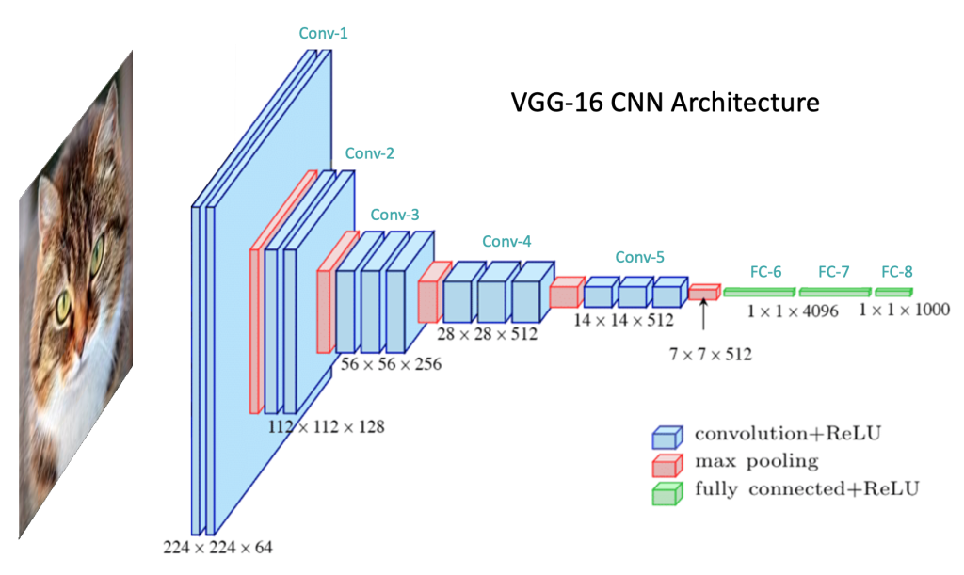
Convolutional neural networks

Slide 4
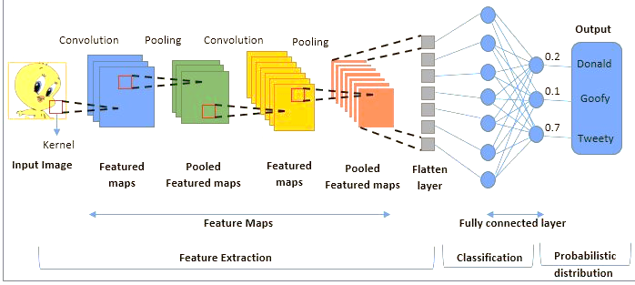
Convolutional neural networks

Slide 5
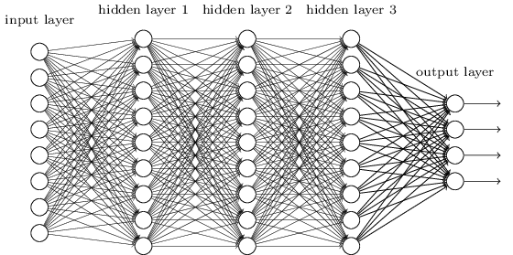
Smaller Network: CNN
We know it is good to learn a small model.
From this fully connected model, do we really need all the edges?
Can some of these be shared?

Slide 6
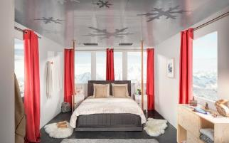
Convolutional Neural Networks (CNNs)
Feature extraction architecture
After 2 convolutional layers, a max-pooling layer reduces the size of the feature maps (typically by 2)
A fully convolutional and a softmax layers are added last to perform classification
Living Room
Bedroom
64
64
128
128
256
256
256
512
512
512
512
512
512
Kitchen
Bathroom
Conv layer
Max Pool
Outdoor
Fully Connected Layer

Slide 7
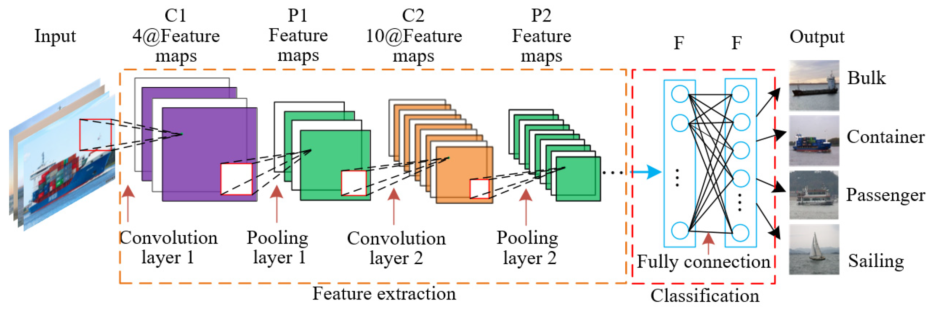
CNN architecture

Slide 8
Convolutional Neural Networks (CovNet)
In a nutshell, A ConvNet usually has 3 types of layers: 1) Convolutional Layer (CONV) 2) Pooling Layer (POOL) 3) Fully Connected Layer (FC)

Slide 9
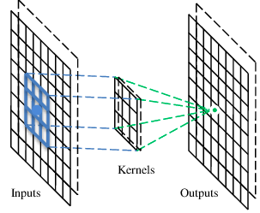
A convolutional layer
A CNN is a neural network with some convolutional layers
(and some other layers). A convolutional layer has a number
of filters that does convolutional operation.
Beak detector
A filter

Slide 10
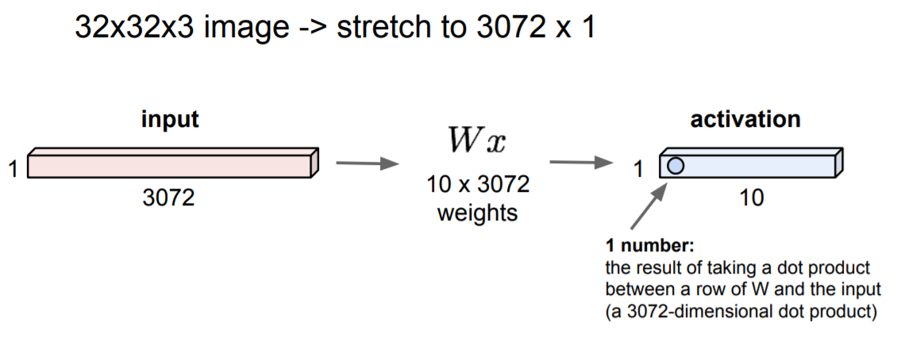
Fully Connected Layer

Slide 11
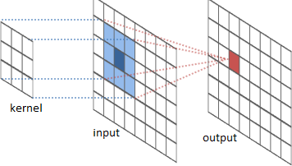
The convolution operation

Slide 12
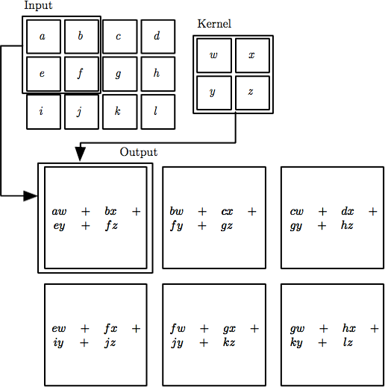

The convolution operation
Local Connectivity. Neurons will connect to only a local region of the input volume.
The spatial extent of this connectivity is a hyperparameter called the receptive field of the neuron (equivalently this is the filter size).

Slide 13
Convolution
These are the network parameters to be learned.
1 | -1 | -1
-1 | 1 | -1
-1 | -1 | 1
1 | 0 | 0 | 0 | 0 | 1
0 | 1 | 0 | 0 | 1 | 0
0 | 0 | 1 | 1 | 0 | 0
1 | 0 | 0 | 0 | 1 | 0
0 | 1 | 0 | 0 | 1 | 0
0 | 0 | 1 | 0 | 1 | 0
Filter 1
-1 | 1 | -1
-1 | 1 | -1
-1 | 1 | -1
Filter 2
……
6 x 6 image
Each filter detects a small pattern (3 x 3).

Slide 14
Convolution
stride=1
1 | -1 | -1
-1 | 1 | -1
-1 | -1 | 1
1 | 0 | 0 | 0 | 0 | 1
0 | 1 | 0 | 0 | 1 | 0
0 | 0 | 1 | 1 | 0 | 0
1 | 0 | 0 | 0 | 1 | 0
0 | 1 | 0 | 0 | 1 | 0
0 | 0 | 1 | 0 | 1 | 0
Dot
product
3
-1
Filter 1
6 x 6 image

Slide 15
Convolution
1 | -1 | -1
-1 | 1 | -1
-1 | -1 | 1
Filter 1
If stride=2
1 | 0 | 0 | 0 | 0 | 1
0 | 1 | 0 | 0 | 1 | 0
0 | 0 | 1 | 1 | 0 | 0
1 | 0 | 0 | 0 | 1 | 0
0 | 1 | 0 | 0 | 1 | 0
0 | 0 | 1 | 0 | 1 | 0
3
-3
6 x 6 image

Slide 16
Convolution
Filter 1
stride=1
1 | -1 | -1
-1 | 1 | -1
-1 | -1 | 1
1 | 0 | 0 | 0 | 0 | 1
0 | 1 | 0 | 0 | 1 | 0
0 | 0 | 1 | 1 | 0 | 0
1 | 0 | 0 | 0 | 1 | 0
0 | 1 | 0 | 0 | 1 | 0
0 | 0 | 1 | 0 | 1 | 0
3
-1
-3
-1
-3
1
0
-3
-3
-3
0
1
3
-2
-2
-1
6 x 6 image

Slide 17
Convolution
-1 | 1 | -1
-1 | 1 | -1
-1 | 1 | -1
Filter 2
stride=1
Repeat this for each filter
1 | 0 | 0 | 0 | 0 | 1
0 | 1 | 0 | 0 | 1 | 0
0 | 0 | 1 | 1 | 0 | 0
1 | 0 | 0 | 0 | 1 | 0
0 | 1 | 0 | 0 | 1 | 0
0 | 0 | 1 | 0 | 1 | 0
3
-1
-3
-1
-1
-1
-1
-1
-3
1
0
-3
-1
-1
-2
1
Feature
Map
-3
-3
0
1
-1
-1
-2
1
3
-2
-2
-1
6 x 6 image
-1
0
-4
3
Two 4 x 4 images
Forming 2 x 4 x 4 matrix

Slide 18
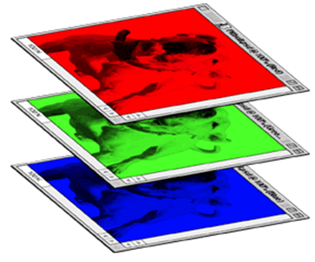
Color image: RGB 3 channels
1 | -1 | -1
-1 | 1 | -1
-1 | -1 | 1
-1 | 1 | -1
-1 | 1 | -1
-1 | 1 | -1
1 | -1 | -1
-1 | 1 | -1
-1 | -1 | 1
-1 | 1 | -1
-1 | 1 | -1
-1 | 1 | -1
1 | -1 | -1
-1 | 1 | -1
-1 | -1 | 1
-1 | 1 | -1
-1 | 1 | -1
-1 | 1 | -1
Filter 1
Filter 2
Color image
1 | 0 | 0 | 0 | 0 | 1
0 | 1 | 0 | 0 | 1 | 0
0 | 0 | 1 | 1 | 0 | 0
1 | 0 | 0 | 0 | 1 | 0
0 | 1 | 0 | 0 | 1 | 0
0 | 0 | 1 | 0 | 1 | 0
1 | 0 | 0 | 0 | 0 | 1
0 | 1 | 0 | 0 | 1 | 0
0 | 0 | 1 | 1 | 0 | 0
1 | 0 | 0 | 0 | 1 | 0
0 | 1 | 0 | 0 | 1 | 0
0 | 0 | 1 | 0 | 1 | 0
1 | 0 | 0 | 0 | 0 | 1
0 | 1 | 0 | 0 | 1 | 0
0 | 0 | 1 | 1 | 0 | 0
1 | 0 | 0 | 0 | 1 | 0
0 | 1 | 0 | 0 | 1 | 0
0 | 0 | 1 | 0 | 1 | 0

Slide 19
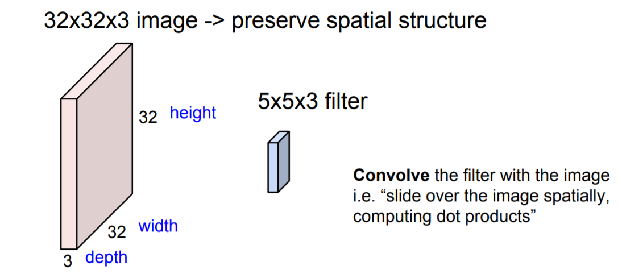
Convolution Layer

Slide 20
Convolution Layer
32x32x3 image
32
height
32
depth
width
3

Slide 21
Convolution Layer
32x32x3 image
5x5x3 filter
32
Convolve the filter with the image
i.e. “slide over the image spatially, computing dot products”
32
3

Slide 22
Convolution Layer
Filters always extend the full
32x32x3 image
depth of the input volume
5x5x3 filter
32
Convolve the filter with the image
i.e. “slide over the image spatially, computing dot products”
32
3

Slide 23


Convolution Layer
32x32x3 image 5x5x3 filter
32
1 number:
the result of taking a dot product between the filter and a small 5x5x3 chunk of the image
(i.e. 5*5*3 = 75-dimensional dot product + bias)
32
3

Slide 24
Convolution Layer
activation map
32x32x3 image 5x5x3 filter
32
28
convolve (slide) over all spatial locations
32
28
3
1

Slide 25
Convolution Layer
32x32x3 image 5x5x3 filter
activation maps
32
28
convolve (slide) over all spatial locations
32
28
consider a second, green filter
3
1

Slide 26
For example, if we had 6 5x5 filters, we’ll get 6 separate activation maps:
activation maps
32
28
Convolution Layer
32
28
3
6
We stack these up to get a “new image” of size 28x28x6!

Slide 27
Preview: ConvNet is a sequence of Convolutional Layers, interspersed with activation functions
32
28
24
….
CONV, ReLU
e.g. 6 5x5x3 filters
CONV, ReLU
e.g. 10 5x5x6 filters
CONV, ReLU
32
28
24
3
6
10

Slide 28
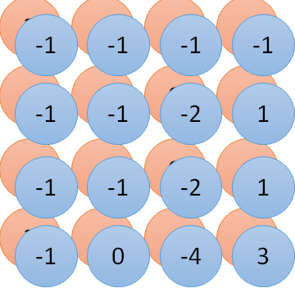
Convolution v.s. Fully Connected
1 | 0 | 0 | 0 | 0 | 1
0 | 1 | 0 | 0 | 1 | 0
0 | 0 | 1 | 1 | 0 | 0
1 | 0 | 0 | 0 | 1 | 0
0 | 1 | 0 | 0 | 1 | 0
0 | 0 | 1 | 0 | 1 | 0
1 | -1 | -1
-1 | 1 | -1
-1 | -1 | 1
-1 | 1 | -1
-1 | 1 | -1
-1 | 1 | -1
convolution
image
1 | 0 | 0 | 0 | 0 | 1
0 | 1 | 0 | 0 | 1 | 0
0 | 0 | 1 | 1 | 0 | 0
1 | 0 | 0 | 0 | 1 | 0
0 | 1 | 0 | 0 | 1 | 0
0 | 0 | 1 | 0 | 1 | 0
Fully-connected
……
……

Slide 29
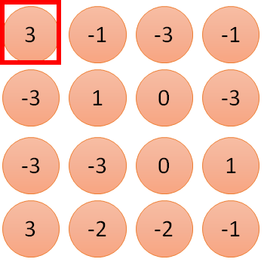
1 | -1 | -1
-1 | 1 | -1
-1 | -1 | 1
1
1
Filter 1
2
0
3
0
3
4:
0
1 | 0 | 0 | 0 | 0 | 1
0 | 1 | 0 | 0 | 1 | 0
0 | 0 | 1 | 1 | 0 | 0
1 | 0 | 0 | 0 | 1 | 0
0 | 1 | 0 | 0 | 1 | 0
0 | 0 | 1 | 0 | 1 | 0
…
0
8
1
9
0
10:
0
…
13
0
6 x 6 image
14
0
fewer parameters!
15
Only connect to 9 inputs, not fully connected
1
16
1
…

Slide 30
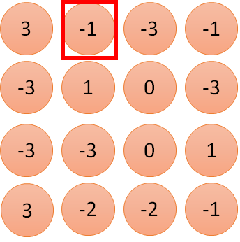
1 | -1 | -1
-1 | 1 | -1
-1 | -1 | 1
1:
1
Filter 1
2:
0
3:
0
3
4:
0
1 | 0 | 0 | 0 | 0 | 1
0 | 1 | 0 | 0 | 1 | 0
0 | 0 | 1 | 1 | 0 | 0
1 | 0 | 0 | 0 | 1 | 0
0 | 1 | 0 | 0 | 1 | 0
0 | 0 | 1 | 0 | 1 | 0
…
7:
0
8:
1
-1
9:
0
10:
0
…
13:
0
6 x 6 image
14:
0
Fewer parameters
15:
1
16:
1
Shared weights
Even fewer parameters
…

Slide 31
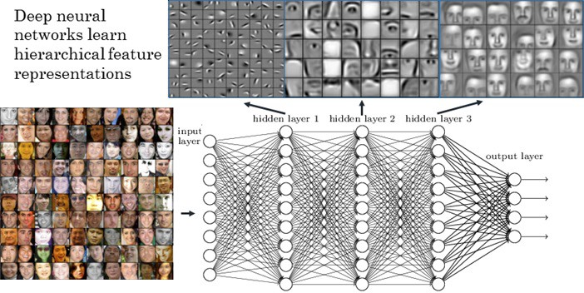
Visualize the Results

Slide 32
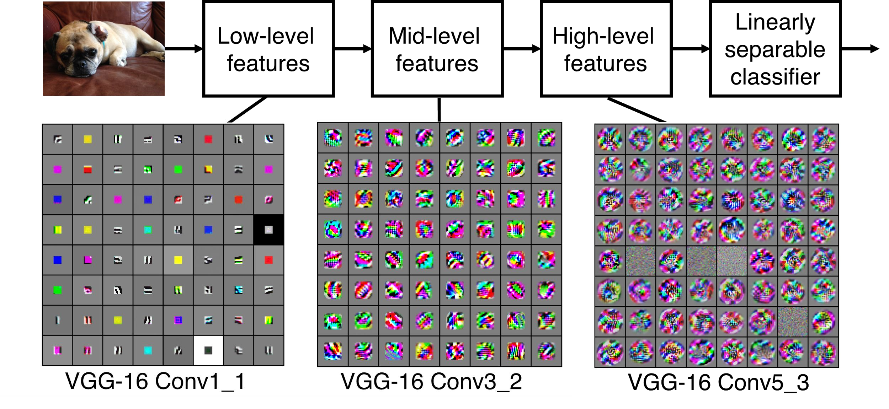
Preview
[Zeiler and Fergus 2013]
Visualization of VGG-16 by Lane McIntosh. VGG-16 architecture from [Simonyan and Zisserman 2014].
Fei-Fei Li & Justin Johnson & Serena Yeung April 18, 2017Lecture 5 -

Slide 33
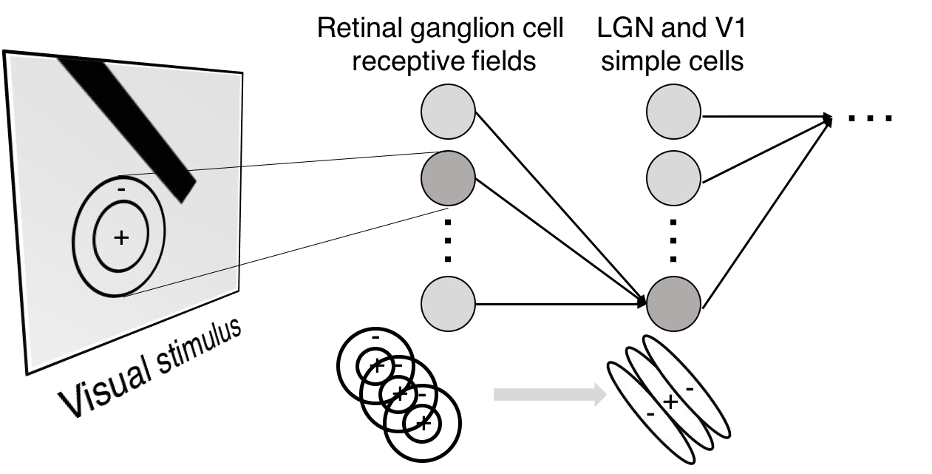
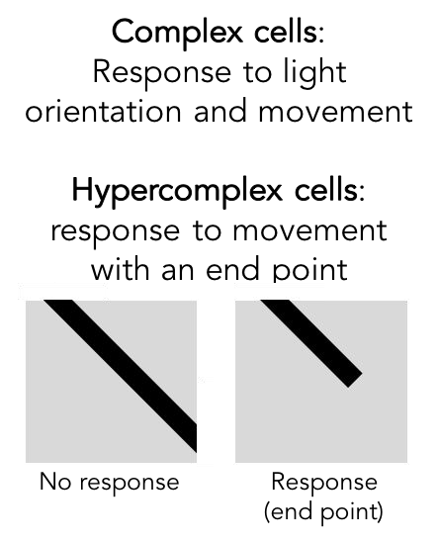
Preview

Slide 34
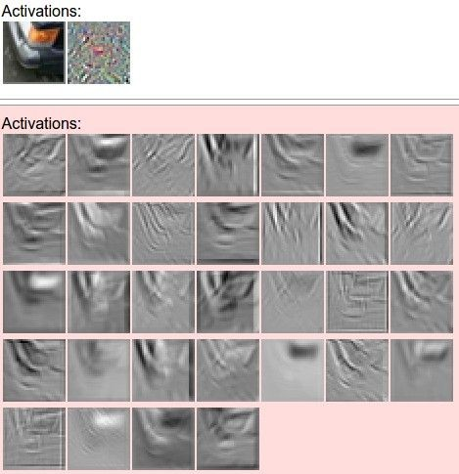

one filter =>
one activation map
example 5x5 filters
(32 total)
We call the layer convolutional because it is related to convolution of two signals:
elementwise multiplication and sum of a filter and the signal (image)
Figure copyright Andrej Karpathy.

Slide 35
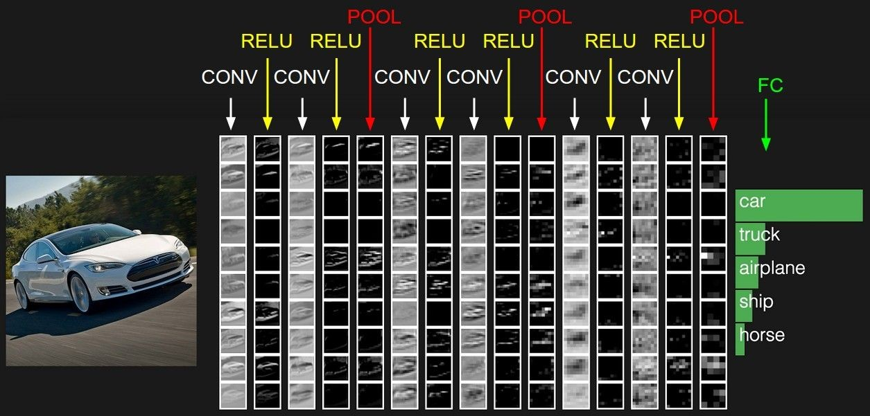
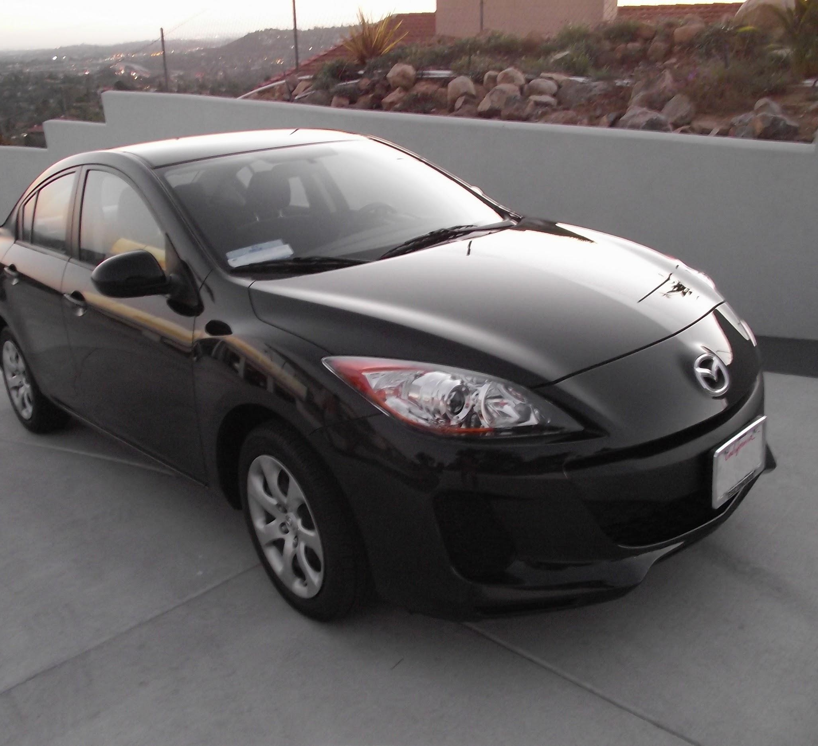
preview:
Fei-Fei Li & Justin Johnson & Serena Yeung April 18, 2017Lecture 5 -

Slide 36
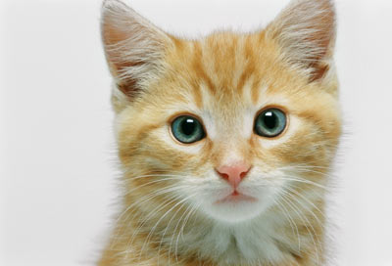
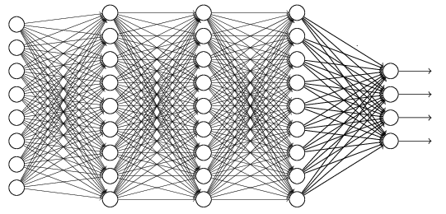
The whole CNN
cat dog ……
Convolution
Max Pooling
Can repeat many times
Fully Connected Feedforward network
Convolution
Max Pooling
Flattened

Slide 37
Flattening
3
0
1
3
0
-1
1
3
3
1
-1
0
3
Flattened
1
Fully Connected Feedforward network
0
3

Slide 38


CNN in Keras
Only modified the network structure and input format (vector -> 3-D tensor)
input
Convolution
1 | -1 | -1
-1 | 1 | -1
-1 | -1 | 1
-1 | 1 | -1
-1 | 1 | -1
-1 | 1 | -1
There are 25 3x3 filters.
……
Max Pooling
Input_shape = ( 28 , 28 , 1)
28 x 28 pixels
1: black/white, 3: RGB
Convolution
3
-1
3
Max Pooling
-3
1

Slide 39
CNN in Keras
Only modified the network structure and input format (vector -> 3-D array)
Input
1 x 28 x 28
Convolution
How many parameters for each filter?
9
25 x 26 x 26
Max Pooling
25 x 13 x 13
Convolution
How many parameters
for each filter?
225=
25x9
50 x 11 x 11
Max Pooling
50 x 5 x 5

Slide 40
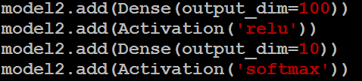
CNN in Keras
Only modified the network structure and input format (vector -> 3-D array)
Input
1 x 28 x 28
Output
Convolution
25 x 26 x 26
Fully connected feedforward network
Max Pooling
25 x 13 x 13
Convolution
50 x 11 x 11
Max Pooling
1250
50 x 5 x 5
Flattened

Slide 41
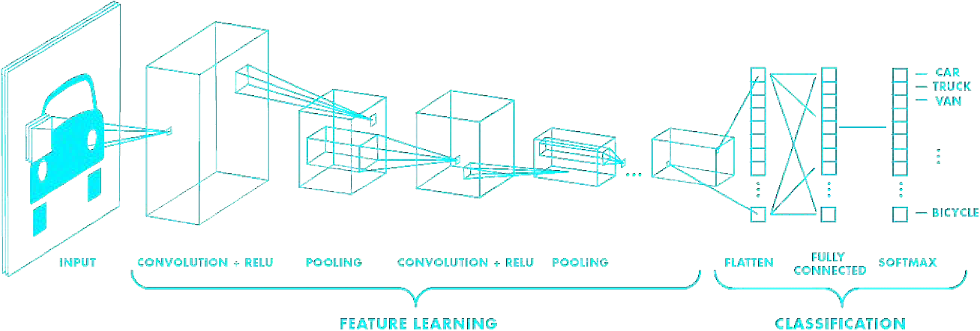
Putting it all together
import tensorflow as tf
def generate_model():
model = tf.keras.Sequential([ # first convolutional layer
tf.keras.layers.Conv2D(32, filter_size=3, activation='relu’), tf.keras.layers.MaxPool2D(pool_size=2, strides=2),
# second convolutional layer
tf.keras.layers.Conv2D(64, filter_size=3, activation='relu’), tf.keras.layers.MaxPool2D(pool_size=2, strides=2),
# fully connected classifier tf.keras.layers.Flatten(), tf.keras.layers.Dense(1024, activation='relu’), tf.keras.layers.Dense(10, activation=‘softmax’) # 10 outputs
])
return model

Slide 42
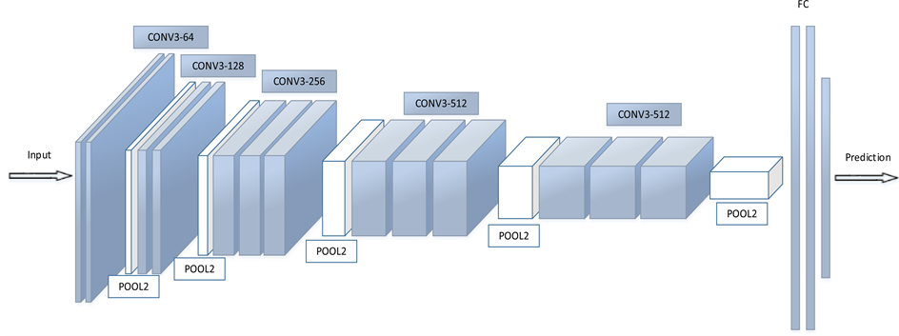
Fully Connected Layers

Slide 43
Fully Connected Layers
Regular neural network
This layer takes an input volume from last layer of CNN and outputs an N dimensional vector.
Where N is the number of classes

Slide 44
Pooling Layer
Pooling is used to progressively reduce the spatial size of the input
To reduce the amount of parameters and computation
It control overfitting (regularization).
Invariance to small translations of the input
Commonly insert a Pooling layer in-between successive Conv layers

Slide 45
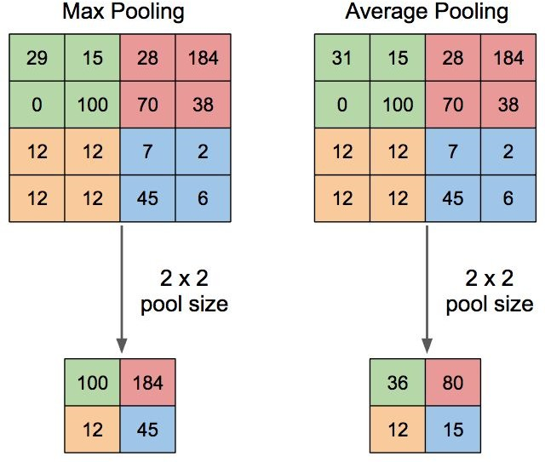
Pooling Layer

